Slide 1
MATRAS
Management Training System
“Optimizing Training System for
Human Performance
by Digitalization system”
Ahmad Abdurrahman : DM2260924
Alvany maulana : DM2260925

Slide 2











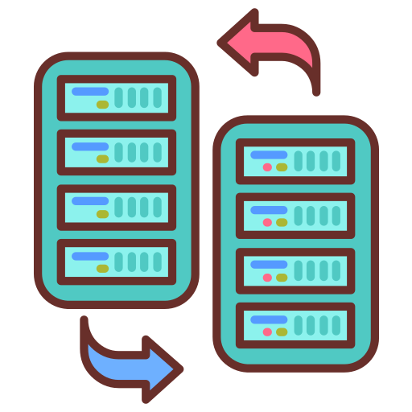
MATRAS
DX
Management Training System
ACTIVITY
TEAM 4
TARGET
WOT
Alvany
Maulana
Ahmad
Abdurrahman
1
Efficiency of Inputting Data
Efficient and Effective
Management Training
System that can detect duplicate participants
GOALS
2
Reduce man hour with effective work and accuracy programming data.
3
Secured participant’s history data
CURRENT PROBLEM
4
Monitoring control by HR directly
There are participants who double the training
so it wastes time
Didalam slide ini harus mengandung kenapa, untuk apa, bagaimana
The data input process is still manual so it is not effective
2. Plant simple
Reduce man hour
There is a repeat of sending participant data through to
HR=>> Muda process

Slide 3
DETAIL SYSTEM
Before improve
Manual data entry:
Participant's Personal Data
Score Each Subject
Score of daily exercise
Proses data
Detect double participant by whatsapp group
Copy and paste personal data until daily score
Manual input data bank participant from summary score
Transfer data to HR
Send to HR data participant passed with email
MCU score Revision Sent Again to Dojo
After improve
Import data entry:
Personal data, sport score, and score each subject
Proses data
Data is automatically integrated and automatically entered into the participant's bank
Tranfer data to HR
With HR features that can directly export data to excel and can edit MCU results
3. Peralatan
Visual code with( php, java script, ajax, html)
Sql server
Web server
visualization
Chart js
bootstrap
4. Fitur
Import participant from excel
Detect participant retraining
Import score each subject
Bank participant automaticly
Export to excel
Dashboard
Hr fitur

Slide 4
RESULT
Implementasi
Gambar mba necha input nilai
Dashboard sudah bisa ditampilin
Penginputan score bisa export
2. Actual Benefit
Data yang diambil
Katika copas participant data diri x langsung import
Input nilai manual permata pelajaran x import permata pelajaran
Pengisian penilaian praktek lebih enak
Pengisian bank participant x sekali pencet langsung terkirim ke bank participant
Update nilai mcu lebih cepet
-REDUCE MAN HOUR-

Slide 5
LEARNING POINT
Strugling point
Adjust the import format of the training dojo data
Change all assessment formats in the add score feature
Import score from Microsoft form
Send result to bank participant(sulit bgt)
Bank participant
Visualization dashboard
2. New finding
Import score
Sent from table in html to database
New fitur bank participant
Export to Excell

Slide 6


Slide 7

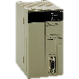
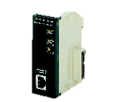
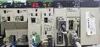




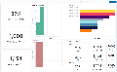

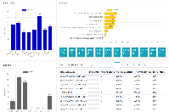

IOT PLC PROJECT
Before IoT, man power have to check manually line condition, such as machine condition, OR Line, Inline Defect, Dandori New Model, Chokotei, Machine Broken, Tool Change Alert.
BACKGROUND
B. Ideal Condition
BF43 main assy line have sufficient infrastructure to support IoT implementation.
Can’t connect to internet
BF43 Current Condition :
BF43 production line has a plan to implement IoT.
However the infrastructure at BF43 Main Assy line doesn’t support for IoT connection (Several PLCs don’t have Ethernet module).
PLC Ethernet module with the same brand is so expensive.
PLC
Ethernet module
In-Line PLC
LAN PORT
Buying Ethernet module at market for same brand
Internet
Omron CS1G CPU45
EXPENSIVE
Network
Visualization
Omron IP module
IoT Implementation
Machine condition item (OR Line, Inline Defect, Dandori, Chokotei, Machine Broken) at production line can be detected automatically using IoT. When those things are detected man power can directly fix it and plan for kaizen that could increase OR.
Network
Can’t visualize machine condition
PT. DENSO MANUFACTURING INDONESIA
Several machines at BF43 line need Ethernet module to support IoT connection
System Development
@ DENSO CORPORATION All Rights Reserved.

Slide 8
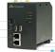

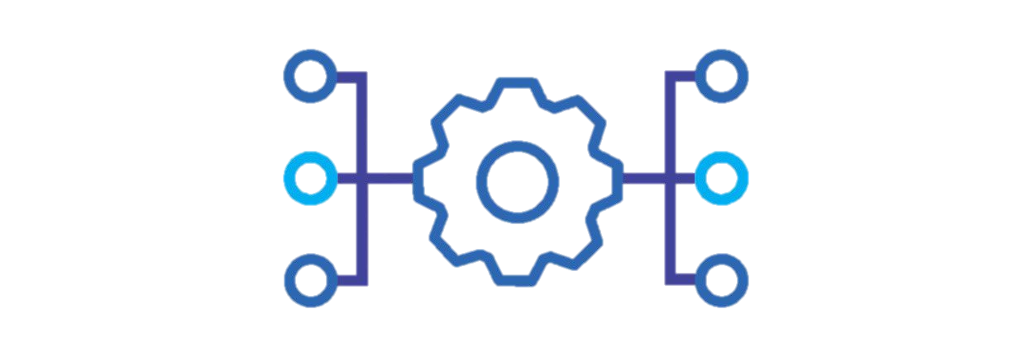







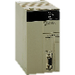
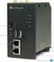

IOT PLC PROJECT
PROJECT’S EXPLANATION
TARGET
PROJECT PURPOSE
Reduce Cost 243MRp
Connecting machine to be IoT device, that can monitor line condition remotely.
Real time visualization of line condition.
Low-cost IoT PLC system
Reduce IoT implementation cost at production line
Real time visualization of line condition.
Haiwell cheaper than other Ethernet module
Low-cost IoT PLC system is a machine monitoring system to visualize line condition, use low-cost middleware as a connector from device to network for low cost IoT implementation.
Omron IP module
Haiwell CBOX
FUNCTION OF IOT PLC
19MRp
2.2MRp
Visualize real time machine condition
Preventive maintenance tool
Analyze machine work
Reduce 16.8MRp per machine
Example implementation at BF43 there are 10 machines with PLC CS1G
IoT Architecture
190MRp
Reduce
168MRp
DEVICE
MIDDLEWARE
DATA ANALYTICS
VISUALIZATION
TOTAL
REDUCE
243MRp
22MRp
Middleware
(PLC to network
communicator)
Connector
(Connecting middleware to database)
Visualization development
75MRp
Reduce
75MRp
0MRp
Dashboard
(Visualization of data record)
Connector
(Connecting EMQX to ELK)
Database
(Data storage)
PT. DENSO MANUFACTURING INDONESIA
Develop Low Cost IoT PLC System & Dashboard Visualization
System Development
@ DENSO CORPORATION All Rights Reserved.

Slide 9
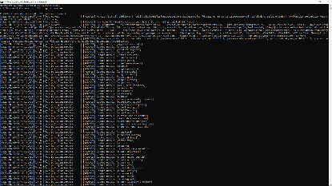
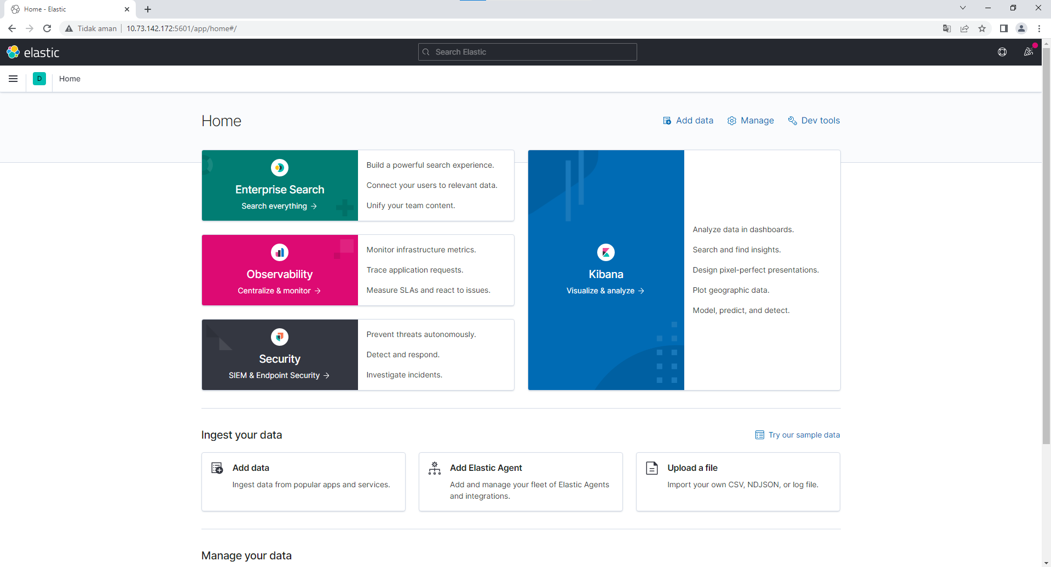


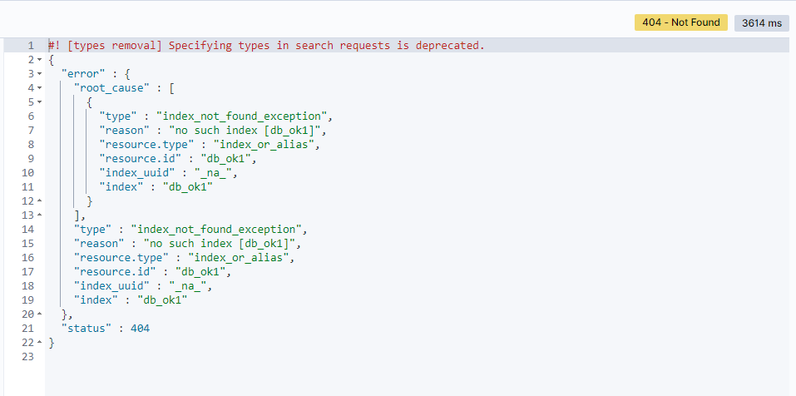
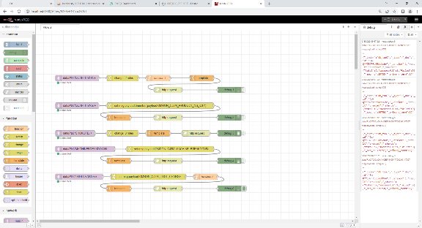


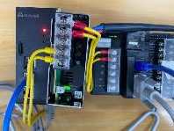
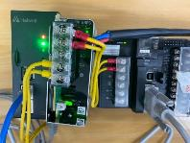


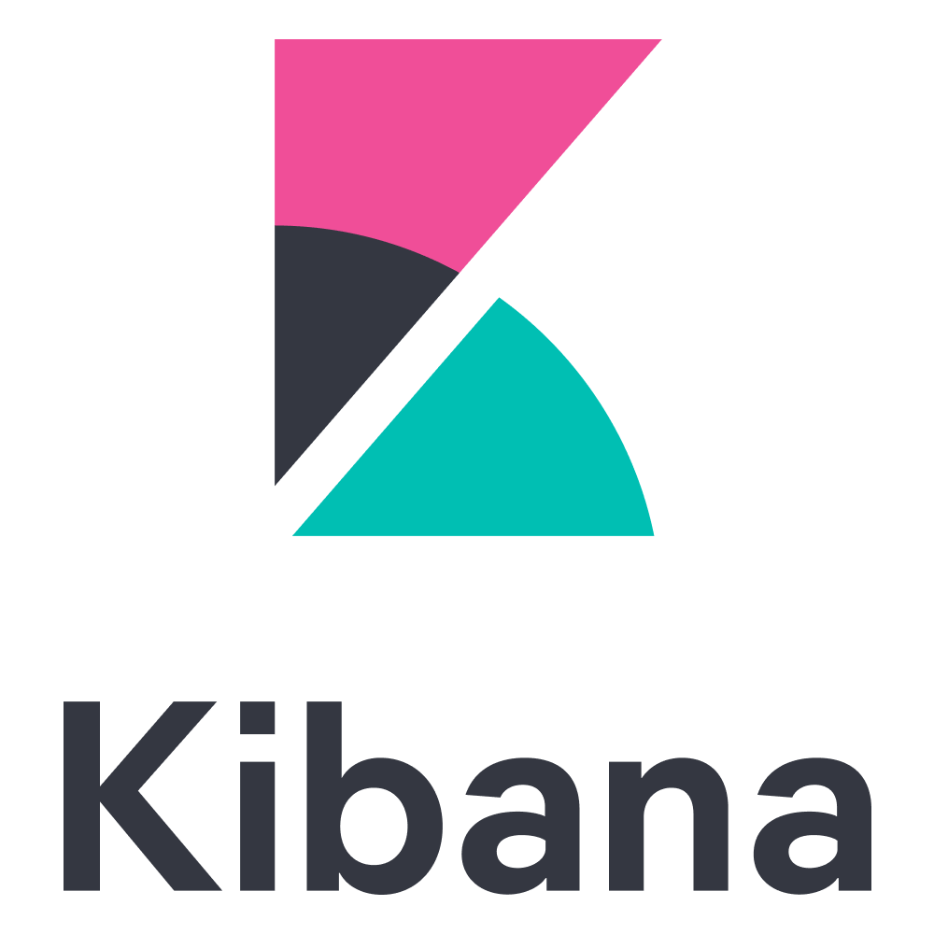
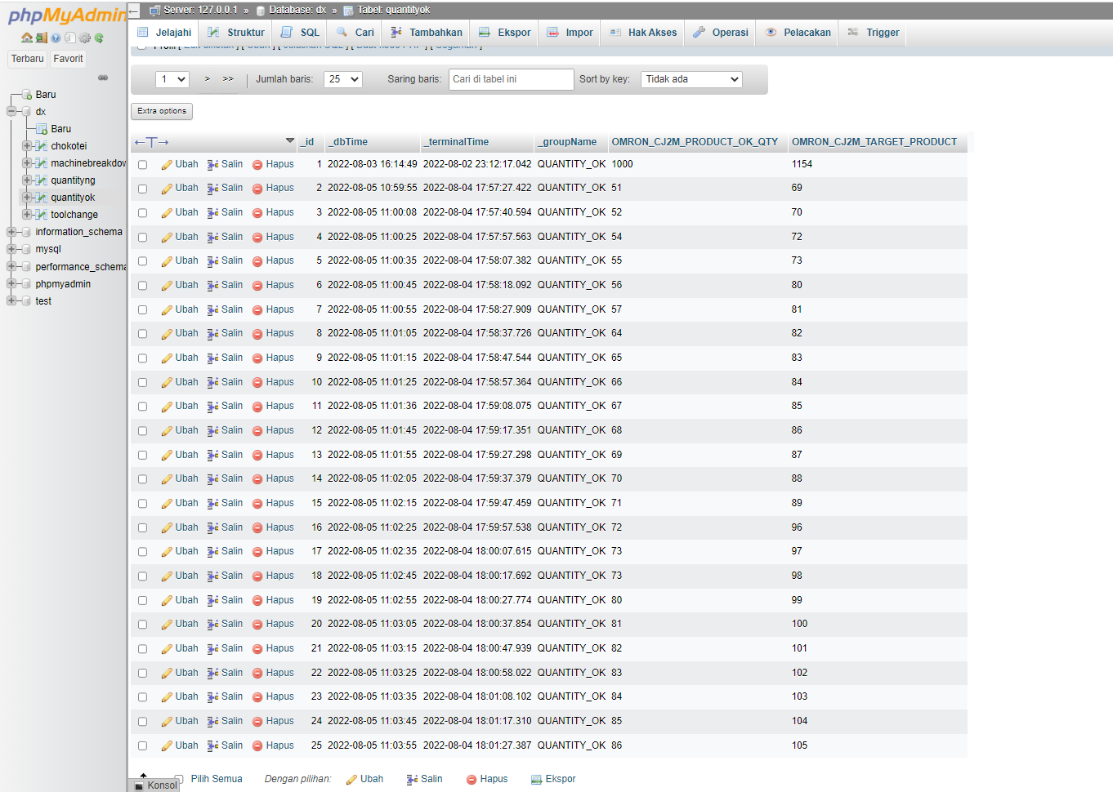
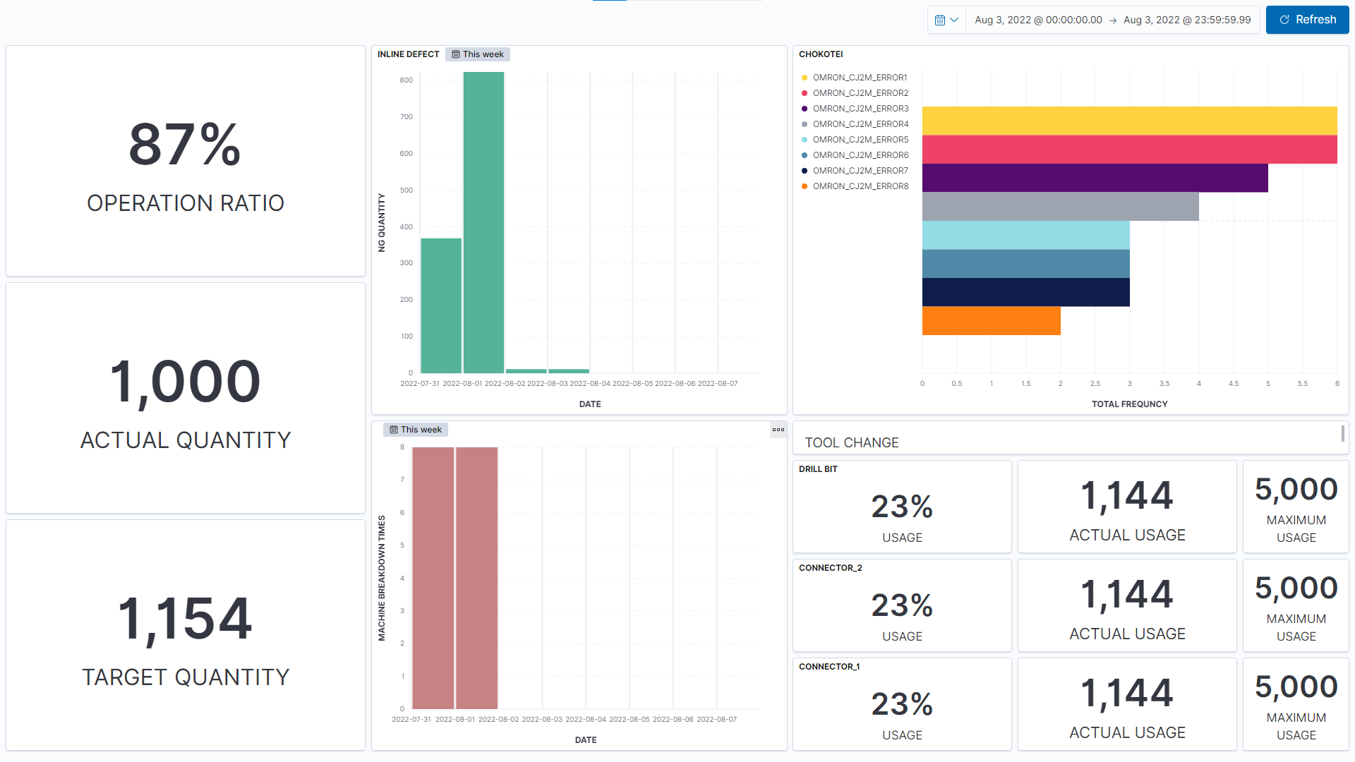
DEVELOPMENT PROCESS
1. CONCEPT DISCUSSION
Discussion Activity
Visiting production line (BF43) to identify PLC of the machine
Define purposes and set target for project with DX department.
Consult with several department
Borrowing PLC to make dummy/prototype
Procurement proposing the application.
Determine device to be used for IoT (dummy)
TWO DEVELOPMENT ACTIVITIES
PROBLEM FOUND AND COUNTERMEASURE
Lag install kibana locally
Access kibana from server
1. CONNECTING PLC TO NETWORK
3. TRIAL AND IMPROVEMENT
1) PLC program
Running Test
Find out the bug
Trial and error the program
Make improvement (Kaizen)
Fixing system
3) Database
Unable send data from EMQX to ELK Stack
Use node red to send data
2) Middleware configuration
4) Data sender
Serial port can not connect
Unplug peripheral
2. VISUALIZATION
Node red schema
1) Data input
2) Index
Visualization editor
Result
Finished around 3 weeks
Connect PLC to network
Visualization
PT. DENSO MANUFACTURING INDONESIA
SUCCEED CONNECTING AND VISUALIZING IOT SYSTEM
System Development
@ DENSO CORPORATION All Rights Reserved.

Slide 10

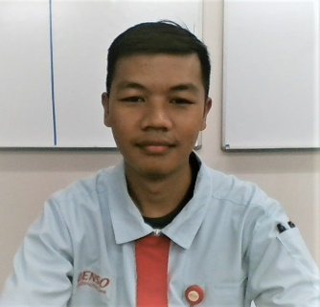
IOT PLC PROJECT
ROLE
SKILL UPGRADE
1.
Make PLC dummy program
Make dashboard
Indexing
Make documentation
Haiwell configuration
PLC Programming
Ingest data elastic
Create Index in Elastic
Create Dashboard use Kibana
Ahmad
Abdurrahman
Node red schema
Before
After
ROLE
SKILL UPGRADE
2.
Connecting PLC to middleware
Connecting data from middleware to Internet
Make node red schema
Make presentation material
Haiwell configuration
PLC Programming
Ingest data elastic
Create Index in elastic
Create Dashboard use kibana
Finished around 3 weeks
Alvany
Maulana
PT. DENSO MANUFACTURING INDONESIA
System Development
OUR SKILLS ARE INCREASED DURING THIS PROJECT
@ DENSO CORPORATION All Rights Reserved.

Slide 11
